Slide 1



Object-Oriented Programming
Thinking in the Object-Oriented Way
SoftUni Team
Technical Trainers
Software University
http://softuni.bg

Slide 2

Table of Contents
What are methods
What is a class?
How to create a class?
What are fields, constructors and properties?
What are delegates and events?
What are namespaces?
What are static members in a class?

Slide 3
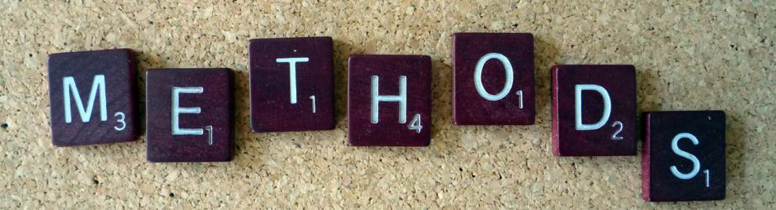
Methods

Slide 4
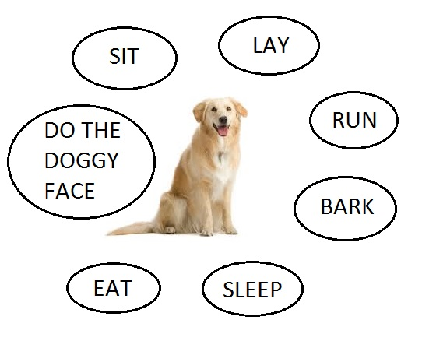
What are Methods?
A method is a block of code containing a series of statements
A method defines the actions or operations supported by a class
The methods of a class represent its behavior

Slide 5
How to Create Methods?
A method is defined by specifying the access level, the return type and the name of the method
Return type
Method name
Access modifier
public class Dog
{
. . .
public void Bark()
{
Console.WriteLine(“Wuf Wuf!”);
Console.WriteLine(“My name is Sharo!”);
Console.WriteLine(“Give me a biscuit!”);
}
}
Method body
Code executed on method call

Slide 6
How to Create Methods?
A method can also be defined with an optional list of parameters in the parentheses
Parameters
public class Dog
{
. . .
public void Bark(string name, int age)
{
Console.WriteLine(“Wuf Wuf!”);
Console.WriteLine(“My name is ” + name);
Console.WriteLine(“I am “ + age + “ years old!”);
Console.WriteLine(“Give me a biscuit!”);
}
}
Use of parameters

Slide 7
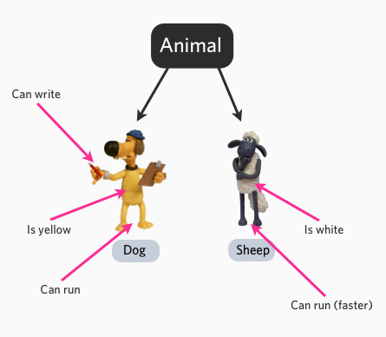
Objects

Slide 8
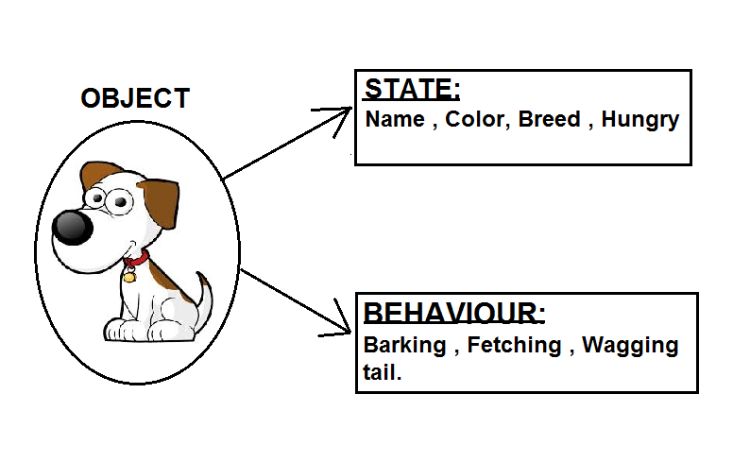
Object-Oriented Programming
Software Objects are conceptually similar to real-world objects
Every real-world object has its own state and behavior
Every complex object is made up of smaller less-complex objects

Slide 9
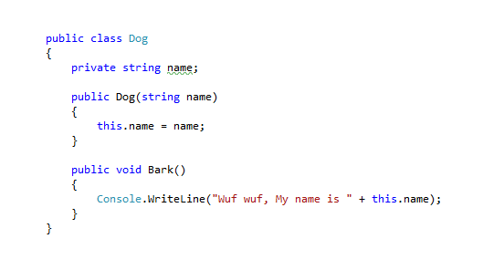
What are Classes?
A class is the template from which individual objects are created
Provides initial values for state and implementations of behaviour.
Can be composed of other classes
An object is also known as an instance of a class

Slide 10
How to Create Classes?
A class is created by using the keyword class. A class has a name, an access modifier, and can have many members and methods
“class” keyword
Class name
Access modifier
public class Dog
{
public Dog(string name)
{
this.Bark(name);
}
public void Bark(string name)
{
Console.WriteLine(“Wuf Wuf! My name is + ” + name);
}
}
Constructor
Method call
Class method

Slide 11
What are Data Fields?
A field is a variable declared in a class body that holds a part of a class's state
Field declaration
public class Dog
{
private string name;
public Dog(string name)
{
this.name = name;
this.Bark();
}
public void Bark()
{
Console.WriteLine(“Wuf Wuf! My name is + ” + this.name);
}
}
Field initialization
Field usage in method
Method call
Class method

Slide 12
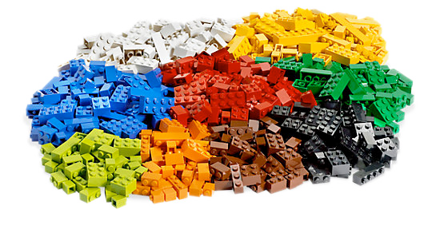
Constructors

Slide 13
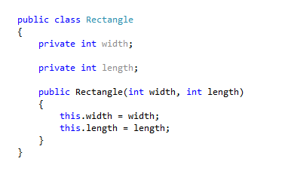
What are Constructors?
Constructors are used to initialize the data members of the object
Special class methods that are executed when a new instance of a class is created
Their main function is to prepare the new object for use

Slide 14
Creating Objects
Objects are created from the templates defined by classes
Parameter for the constructor
namespace Test
{
public class Program
{
public static void Main(string[] args)
{
string dogName = “Sharo”;
Dog myDog = new Dog(dogName);
myDog.Bark();
}
}
}
Initialization
Declaration
Method call

Slide 15
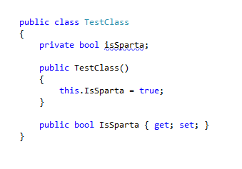
“this” keyword

Slide 16
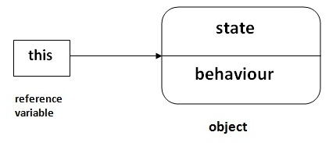
The “this” keyword.
The this keyword can be used to access members from within constructors, instance methods, and accessors of instance properties
The this keyword is a reference to the current instance of the class
The this keyword is used to refer to any member of the current object

Slide 17
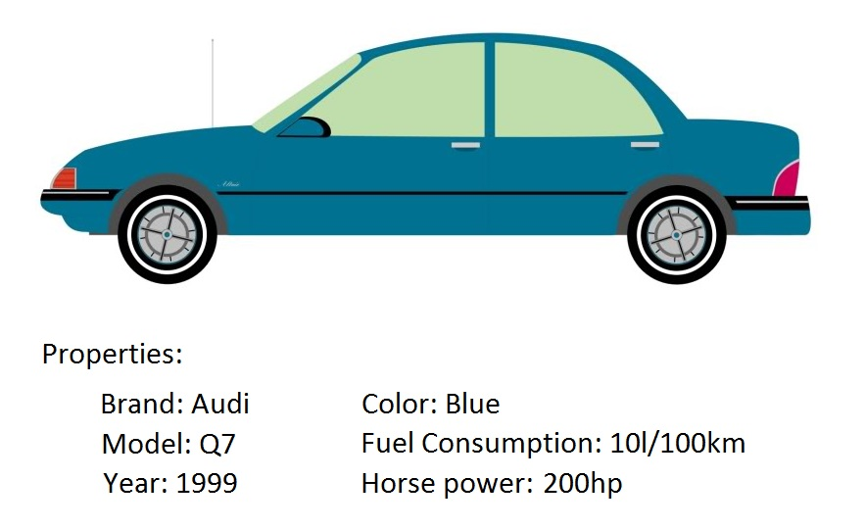
Properties

Slide 18
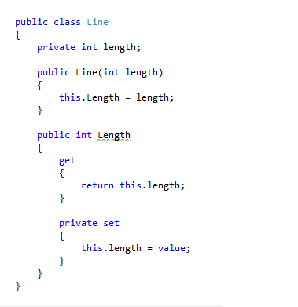
What are Properties?
Properties allow you to access class data in a safe and flexible way
Class members that can be accessed like data fields but contain code like a method
Are often used to expose the data fields of a class in a more controlled manner

Slide 19
What are Auto-implemented Properties?
Auto-implemented properties simplify property declarations
Use of properties
public class Dog
{
public Dog(string name, int age)
{
this.Name = name;
this.Age = age;
}
public string Name { get; set; }
public int Age { get; set; }
}
Auto-implemented properties
Getters and setter are empty

Slide 20
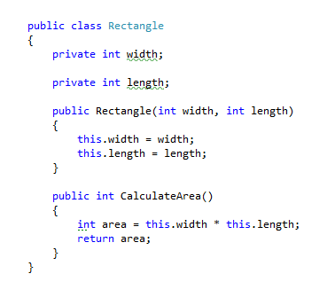
Exercise in class

Slide 21
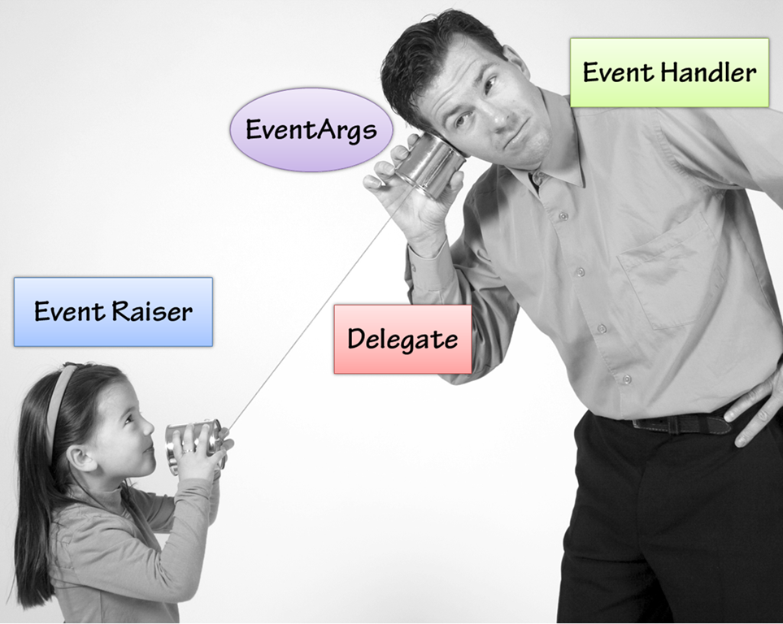
Delegates and Events

Slide 22
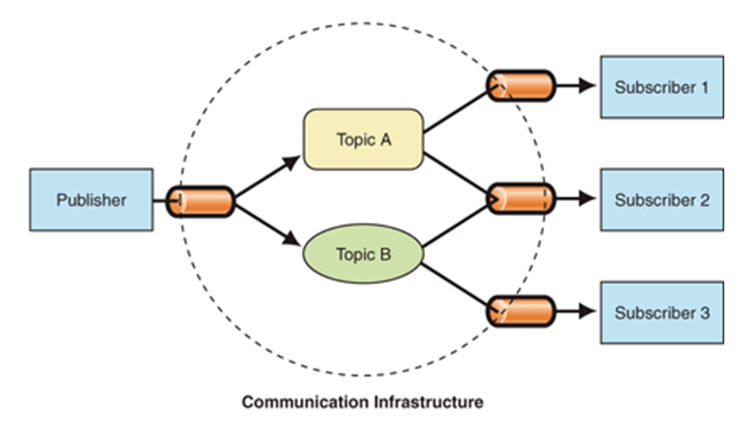
What are Delegates?
Delegates are special types that are used to encapsulate a method with a specific signature
Can be used to declare a variable referring to any method with the same signature as itself
Are used to pass methods as arguments to other methods

Slide 23

What are Events?
Events are a way for a class to notify other classes or objects when something of interest happens
The class that sends the notification is called a publisher of the event
The class that receives the notification is called the subscriber of the event

Slide 24
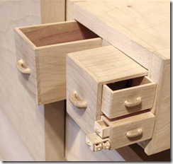
What are Namespaces?
The namespace keyword is used to declare a scope that contains a set of related objects
Allows you to organize code and create globally unique class names
Namespaces implicitly have public access and this is not modifiable

Slide 25
What are Namespaces?
Namespace declaration
namespace Animals
{
public delegate ProcessBark(Dog dog);
public class Dog
{
private string name;
public Dog(string name)
{
this.name = name;
}
. . .
}
}
Simple delegate
Simple class
Class closing scope
Namespace closing scope

Slide 26
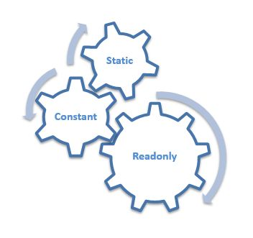
What are Static Members?
Static members belong to a class itself rather than individual objects
A static member is shared by all objects of the class
Static members exist even if no objects of the class have been defined

Slide 27

Summary
What is Object-Oriented Programing?
What is the difference between objects and classes?
What are class members?
How to create objects?
How to use the “.this” keyword?
What are delegates and events?
What are namespaces and static members?

